Slide 1
Automating and Optimizing Tender Response Process using AI - POC
Challenge Description
Ensure that the POC can:
Read and understand the context and requirements of new tender documents
When prompted by a user with a question that appears within a new tender request,
the POC should retrieve and adapt relevant answers from a repository of past tender documents
Generate a draft response that can be easily reviewed and refined
Incorporate a simple feedback mechanism to learn from manual adjustments made by
the sales team to improve its performance over time
The solution should be able to handle large volumes of data from historic examples, be scalable, and ensure data integrity and compliance.
To Do
Provide a high-level solution design for a tender generation POC which includes:
1. Architecture: Draft a high-level architecture diagram showing the key components,
data storage and the feedback loop.
2. Process: Outline a simplified process flow for the POC, detailing the steps from tender
receipt to draft generation and the AI’s role in it.
3. Challenges: Outline the key areas of potential complexity that would have to be
considered and overcome when developing the POC and potential experiments you
might create to test the concept's viability before starting development.

Slide 2
Automating and Optimizing Tender Response Process using AI - POC
Initial Thoughts:
For reading the documents should AI given free hand in writing and executing code? Or
reduce the scope by registering predefined functions to AI Agents?
What AI framework can be used, Langchain, Autogen, CrewAI?
What LLMs to be used open source or OpenAI
Prompting: Zero shot or Few shot
Guardrails to be used to reduce hallucinations and response in scope
Database: Vector Database, MongoDB or blob/storage bucket?
Vector Database – Data is chunked and stored, can be used to retrieve information in chunks, Tender document structure
might be missed. Supports fast retrieval and scalable.
MongoDB or Blob/Storage buckets: Can store documents as files. Retrieval is not as fast as vector database but it stores entire
document. Tender document structure can be preserved, helps LLM in writing draft tender
document similar to previous tender documents structure.
Fine tune LLM to write tender documents in compliance with organizational structure.
Consistency in the output structure.
Tech Selection:
AI framework Autogen, interactions between AI agents are controlled and flexible.
Python Predefined functions to reduce the scope of code execution.
LLM – OpenAI (chatgpt 3.5 turbo), less price and fast response.
Database: Vector Database, MongoDB or Blob/Storage buckets.
Challenges:
Evaluation challenges –
Q & A evaluation strategies – Answer Relevancy, Context Relevancy
Tender Structural Evaluation – Evaluate against predefined structure, say does the draft tender document has
From details, to details, subject line, document signature, paragraph placement.

Slide 3
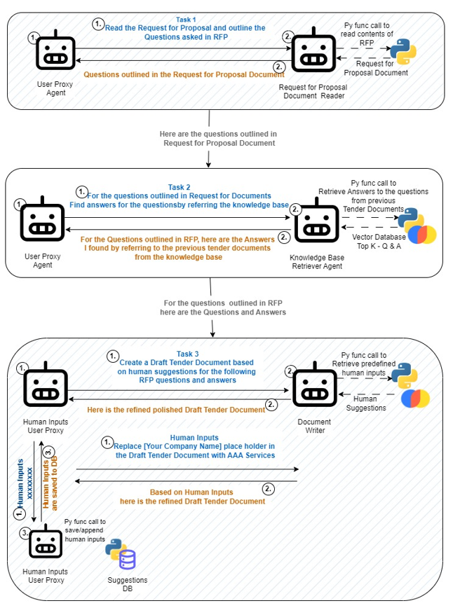
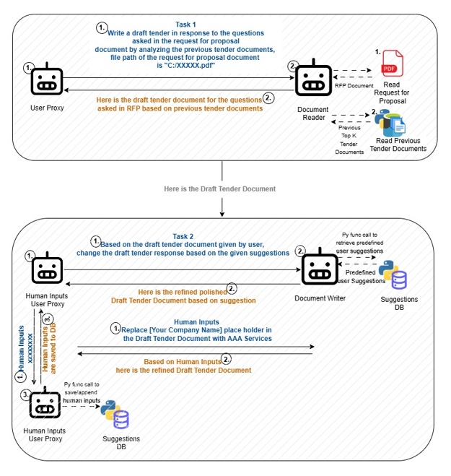
Sequential Agent Chat Architecture 1
Sequential Agent Chat Architecture 2

Slide 4
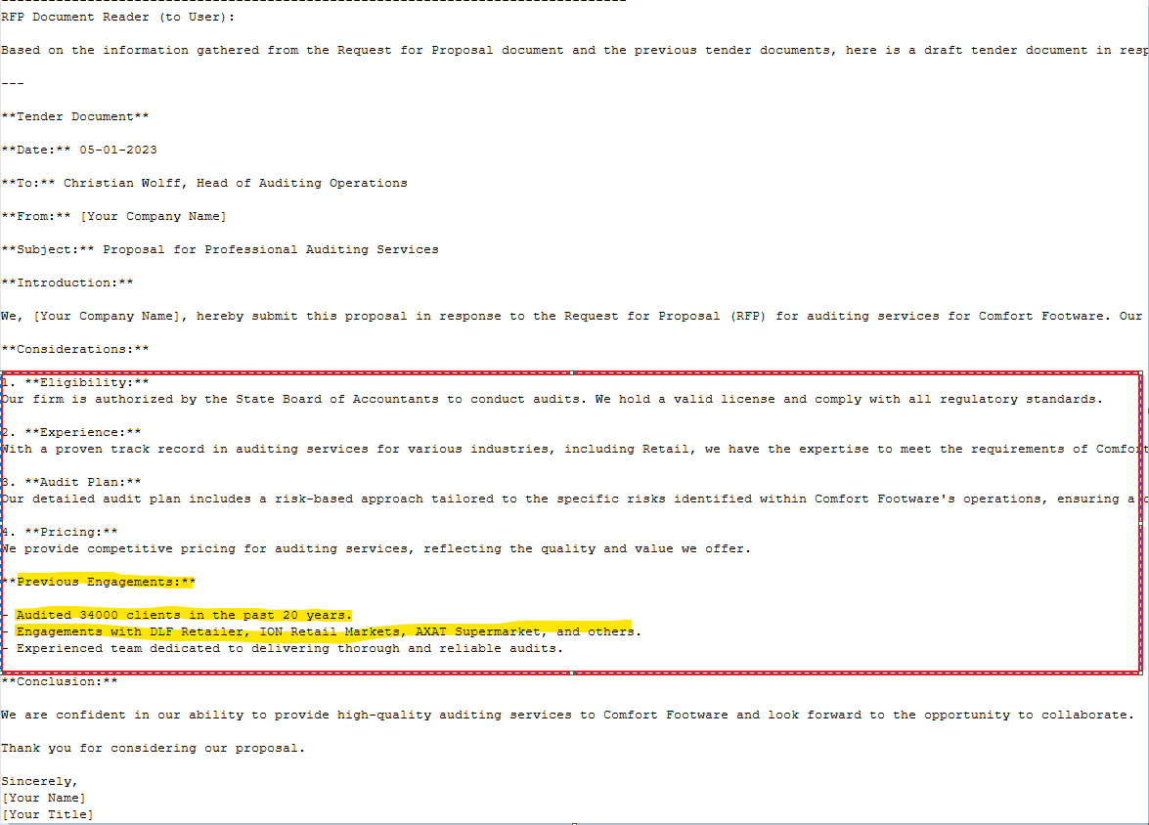
Some Exciting Experiment Results
V1_log.txt – AI agent was able to pull relevant data, interestingly Previous Engagements

Slide 5
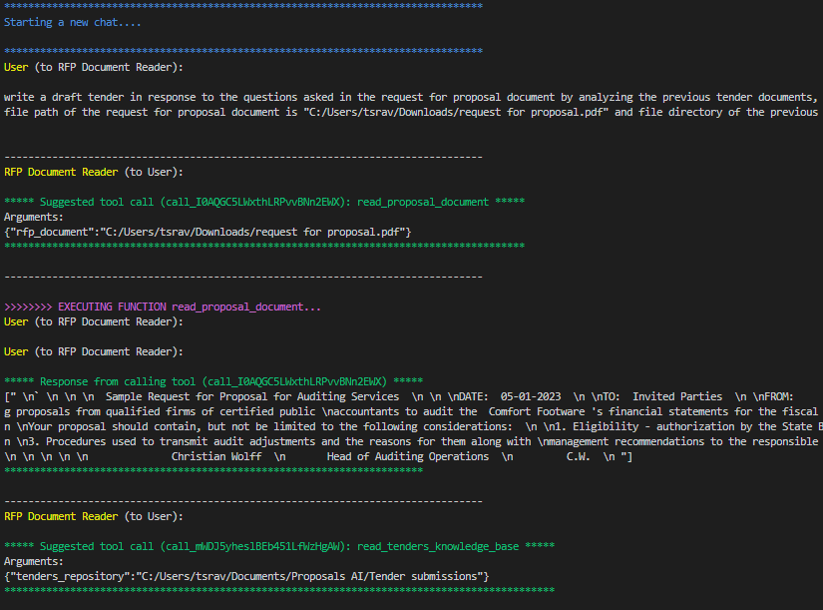
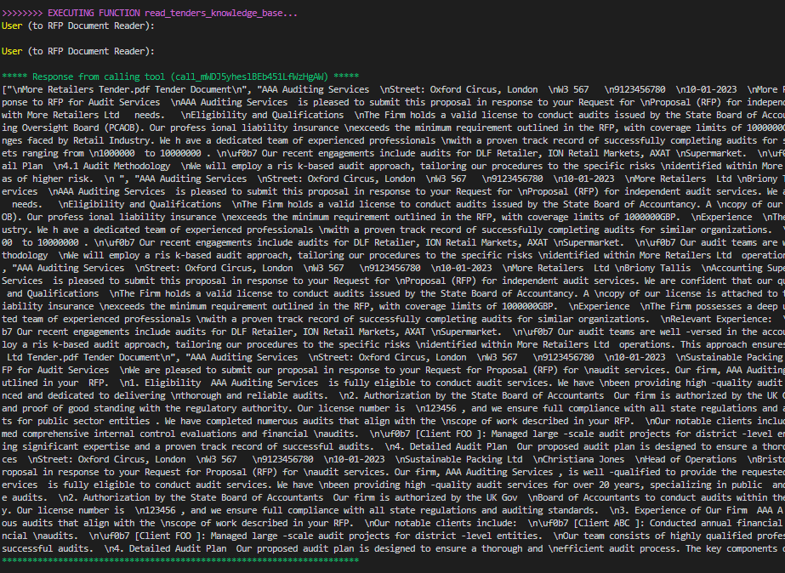
Agents Conversation

Slide 6
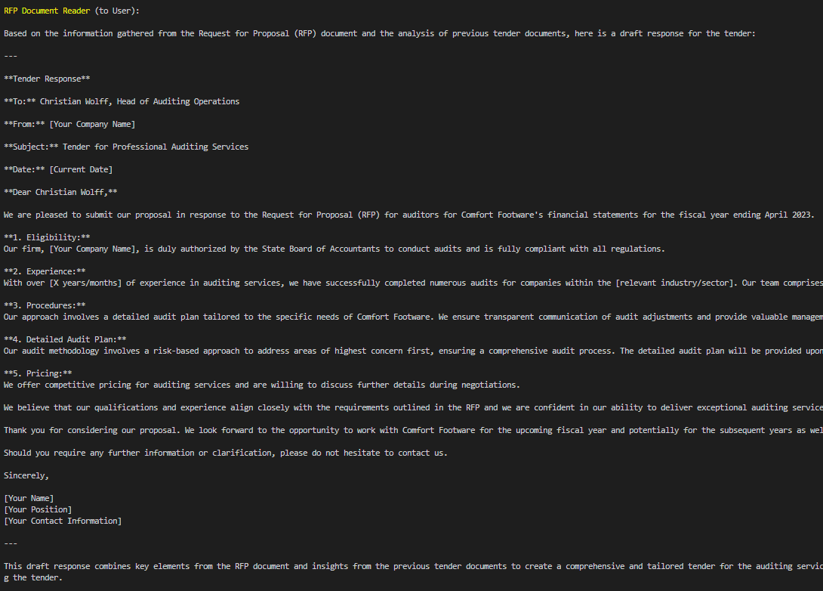
Agents Conversation

